Slide 1

Transmission rate and band width

Slide 2
Transmission Rate
Transmission rate refers to the speed at which data can be transmitted over a communication channel or medium.
It is usually measured in bits per second (bps) and represents the number of bits that can be transmitted in one second.
Transmission rates can vary widely depending on the technology used communication medium being used.
Higher transmission rates allow for faster data transfer and better overall performance in communication systems.

Slide 3
Transmission Rate (continue…/)
Factors affecting transmission rate
Quality of the Communication Channel:
  The quality of the communication channel refers to the overall condition and reliability of the medium through which data is transmitted.
  Factors such as signal attenuation, noise, and distortion can affect the quality of the channel.
  Signal attenuation occurs when the strength of the signal diminishes as it travels through the channel, resulting in a decrease in transmission rate.
  Noise refers to unwanted signals or disturbances that can interfere with the original signal, leading to errors and reducing the effective transmission rate.
  Distortion occurs when the shape or characteristics of the transmitted signal are altered during transmission, which can degrade the data and impact the transmission rate.
Interference:
  Interference refers to the presence of unwanted signals or electromagnetic radiation that can disrupt or degrade the original signal.
  Interference can be caused by various sources, such as other electronic devices, power lines, or even natural phenomena like lightning.
  When interference occurs, the quality of the received signal can be compromised, leading to errors and a decrease in the effective transmission rate.
  To mitigate interference, techniques such as shielding, filtering, and error correction codes are employed to improve the transmission rate and maintain data integrity.

Slide 4
Transmission Rate (continue…/)
Factors affecting transmission rate
Distance between the Sender and Receiver:
  The distance between the sender and receiver can affect the transmission rate due to signal degradation over distance.
  As the distance increases, the strength of the signal diminishes, leading to signal attenuation and a decrease in the effective transmission rate.
  To overcome the limitations posed by distance, amplification and signal regeneration techniques may be used to boost the signal strength and maintain an acceptable transmission rate.
  In long-distance communication, the use of repeaters or signal amplifiers at regular intervals helps to extend the reach and maintain the desired transmission rate.

Slide 5
Bandwidth
Bandwidth refers to the maximum amount of data that can be transmitted over a communication channel in a given amount of time.
It is typically measured in bits per second (bps) or hertz (Hz) and represents the capacity of the channel to carry data.
A wider bandwidth allows for the transmission of more data simultaneously, resulting in higher data rates and better overall performance.
Bandwidth is not the same as transmission rate; the transmission rate represents the actual speed at which data is transmitted, while bandwidth refers to the channel's capacity to carry data.

Slide 6
Bandwidth (continue…/)
Factors affecting bandwidth
Physical Properties of the Communication Medium:
  The physical properties of the medium through which the communication signals are transmitted play a crucial role in determining the bandwidth.
  For example, in wired systems, the characteristics of the cables, such as their thickness, material, and resistance, affect the data-carrying capacity.
  In wireless systems, factors like frequency range, available spectrum, and environmental conditions (e.g., interference, obstacles) impact the achievable bandwidth.
Technology Being Used:
  Different communication technologies have varying bandwidth capabilities.
  For instance, older dial-up modems had limited bandwidth capacities, typically around 56 Kbps.
  On the other hand, modern technologies like fiber optics, DSL (Digital Subscriber Line), cable, and wireless technologies such as 4G/5G provide much higher bandwidths, ranging from Mbps to Gbps.
  The specific technology used determines the maximum data rates that can be achieved.

Slide 7
Bandwidth (continue…/)
Factors affecting bandwidth (continue../)
Signal Processing Techniques:
  Signal processing techniques can enhance the effective bandwidth by optimizing data transmission.
  Techniques like modulation, coding, and compression are used to encode and compress data, allowing more information to be transmitted within the available bandwidth.
Network Congestion:
  Bandwidth can also be influenced by network congestion, especially in shared networks.
  When multiple users or devices are accessing the same network simultaneously and generating high traffic, the available bandwidth is divided among them.
  This can lead to slower data transfer rates and reduced overall bandwidth for each user

Slide 8
Bandwidth (continue…/)
Factors affecting bandwidth (continue../)
Quality of Service (QoS) Requirements:
  In some cases, specific applications or services may require a certain level of bandwidth to function optimally.
  For example, real-time applications like video conferencing or online gaming demand higher bandwidth to ensure smooth and uninterrupted data transmission.
  In such cases, network administrators may allocate dedicated bandwidth or prioritize certain traffic to meet the QoS requirements.

Slide 9
Relationship between Transmission Rate and Bandwidth.
The transmission rate and bandwidth are related but not interchangeable terms.
The transmission rate is a measure of the actual speed at which data is transmitted, while bandwidth refers to the channel's capacity.
The transmission rate cannot exceed the bandwidth of the channel, as it is limited by the channel's capacity.
However, the transmission rate can be lower than the bandwidth if the channel is not fully utilized or if there are other limiting factors.
In practical terms, achieving higher transmission rates requires a communication medium with a wider bandwidth or the use of more advanced modulation techniques to increase the data-carrying capacity within the available bandwidth.

Slide 10

Signals, types of signals and standards

Slide 11
What are signals?
Signals are electrical, electromagnetic, or optical representations of data or information.
They are used to transmit, convey, or store information in various systems, including communication, electronics, and computing.
Signals can take different forms and can be classified based on their characteristics and properties.

Slide 12
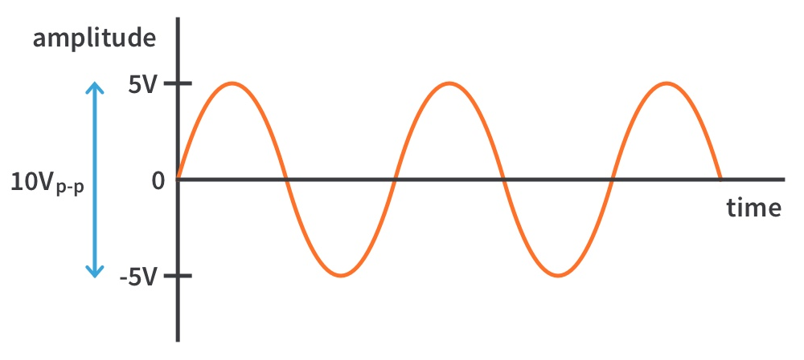
Types of signals
Analog Signals
Analog signals are continuous signals that represent information using varying physical quantities such as voltage, current, or frequency.
They can take on any value within a specific range and are used to convey real-world phenomena, such as sound, temperature, or pressure.
Analog signals are susceptible to noise and distortion during transmission, which can degrade the quality of the signal.

Slide 13
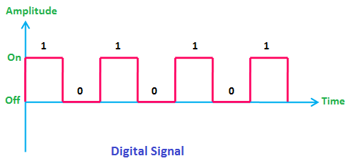
Types of signals …
Digital Signals
Digital signals are discrete signals that represent information using binary digits (bits), which can take on only two possible values: 0 and 1.
They are more resistant to noise and distortion compared to analog signals, as they can be accurately regenerated.
Digital signals are widely used in modern communication systems, computer networks, and digital devices.

Slide 14
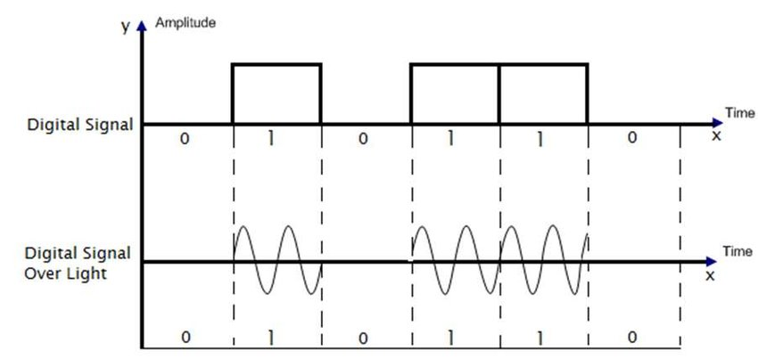
Types of signals …
Hybrid Signals
Hybrid signals combine elements of both analog and digital signals.
They represent information using a combination of continuous and discrete values.
Hybrid signals are commonly used in telecommunications systems, where analog signals are converted to digital for transmission over digital networks.
Digital subscriber line (DSL) is an example of a hybrid signal, where voice signals are carried over telephone lines using digital modulation techniques.

Slide 15
Signal Standards
Signal standards, also known as communication standards or protocols, define the rules, specifications, and formats that govern the transmission, reception, and interpretation of signals in a specific system or application.
These standards ensure interoperability, compatibility, and efficient communication between devices and systems.
Some of these standards include:

Slide 16
Signal Standards…
Communication Standards:
  Communication standards define the protocols, formats, and procedures required for devices to communicate with each other.
  Standards ensure interoperability and compatibility between different devices and systems.
  Examples of communication standards include Ethernet (IEEE 802.3), Wi-Fi (IEEE 802.11), Bluetooth (IEEE 802.15.1), and GSM (Global System for Mobile Communications).
Data Transmission Standards:
  Data transmission standards specify the rules and specifications for transmitting data over various communication channels.
  They define the physical and electrical characteristics of the transmission medium, modulation techniques, error detection and correction methods, and data framing.
  Examples of data transmission standards include RS-232, USB (Universal Serial Bus), HDMI (High-Definition Multimedia Interface), and Ethernet (IEEE 802.3).

Slide 17
Signal Standards ….
Internet and Networking Standards:
  Internet and networking standards govern the protocols and technologies used for communication and data exchange over computer networks.
  These standards enable the seamless transfer of data between different networks and devices.
  Examples of internet and networking standards include TCP/IP (Transmission Control Protocol/Internet Protocol), HTTP (Hypertext Transfer Protocol), DNS (Domain Name System), and Wi-Fi (IEEE 802.11).

Slide 18

Transmission media

Slide 19
What is transmission media
Transmission media, also known as communication channels or communication media, refer to the pathways or mediums through which signals are transmitted from one location to another.
Transmission media can be categorized into three main types based on their physical nature:
  Guided media
  Unguided media
  Wireless media

Slide 20
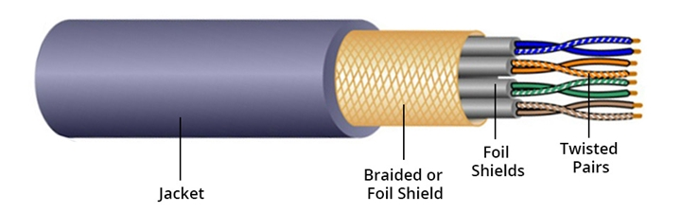
Guided transmission media
Guided media, also known as bounded or wired media, refer to transmission media that provide a physical pathway for signals to travel through.
Examples of guided media include:
  Twisted Pair Cable: Consists of pairs of copper wires twisted together and is commonly used for telephone lines and Ethernet connections.

Slide 21
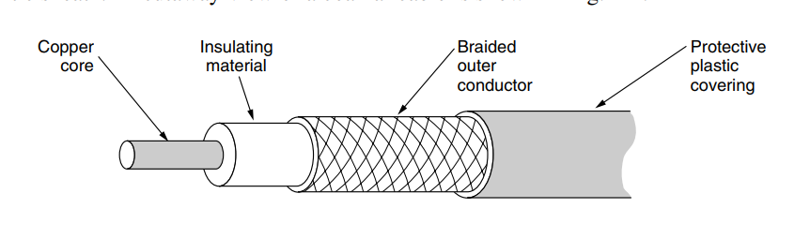
Guided transmission media…
  Coaxial Cable
    Consists of a central conductor, an insulating layer, a metal shield, and an outer insulating layer.
    It is used for cable television (CATV) and high-speed data transmission.

Slide 22
Guided transmission media…
  Fiber Optic Cable
    A fiber optic cable is made up of glass or plastic and transmits signals in the form of light.
    Light travels in a straight line as long a it is moving through a single uniform substance.
    Optical fiber use reflection to guide light through a channel.
    Fiber optics are used for long-haul transmission in network backbones, high speed LANs.
    An Optical Transmission System has three key components:
      The light source – it generates light signal that will be transmitted through the fiber optic cable.
      Transmission medium – Ultra-thin fiber of glass or plastic, it is made up of a core (where light travels) and cladding (which reflects the light back)
      The detector – This is responsible for converting the light signal back into electrical signal that can be processed by electronic devices. The most common detector is photodiode.

Slide 23

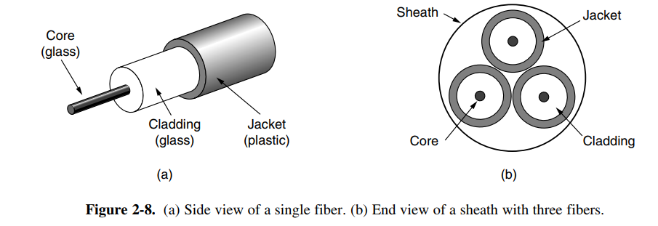

Slide 24
Unguided transmission media
Unguided media, also known as unbounded or wireless media, are transmission media where signals propagate through the air or free space without a physical medium.
  Examples of unguided media include:
    Radio Waves: Used in radio communication, wireless networking (Wi-Fi), and cellular networks.
    Microwaves: Used for point-to-point communication links and satellite communication.
    Infrared Waves: Used in short-range communication, such as infrared remote controls.

Slide 25
Wireless transmission media
Wireless media is a specific subset of unguided media that refers to transmission media used for wireless communication.
  Examples includes:
    Wi-Fi (IEEE 802.11): Enables wireless local area network (WLAN) communication within a limited range.
    Bluetooth (IEEE 802.15): Used for short-range wireless communication between devices, such as smartphones, computers, and peripherals.
    Cellular Networks: Enable wireless communication over large geographic areas using technologies like 2G, 3G, 4G LTE, and 5G.
    Near Field Communication (NFC): NFC enables wireless communication between devices over short distances, typically a few centimeters.
      It is used for contactless payments, data exchange between devices by tapping them together, and accessing information from NFC tags.

Slide 26
